Slide 1
Data Analytics Capstone
Is the Remote World the Future?
By: Anashae Harriott

Slide 2
TABLE OF CONTENTS
01
02
03
04
INTRODUCTION/ MOTIVATION
DATA SOURCE
METHODOLOGIES
Why I believe this matters
Where I pulled my data from
How I analyzed the data for this project
05
06
FINDINGS
CONCLUSIONS
Wrap-up w/ Q&A
What the data revealed
What i learned
Notes:
This is table of contents or rather my checklist to ensure I cover all my bases and deliver everything that was going on in my head into yours:)

Slide 3
01
INTRODUCTION
This analysis was conducted to gain insight to the impact of remote work on job performance and overall employee satisfaction as more companies transition to in-person and on site requirements post covid and quarantine years.
Notes:
Introduction, My Why? I want to see if there was data to support the impact of of remote work on job performand and job satisfaction. The post covid and Quarantine error has cadapulted our society and especially the corporate and career work world to be heavily technology oriented. From how we submit our deliverable to how we meet our teams. Personally I started at healthfirst in the quarantine era in a remote position , so I have never seen the inside of the office. In the most recent yearscompanies including HF have been trending to a more Hybrid or Fully in person structure. I believe early last year Healthfirst collected data on remote work from the employees to gain an insight to the impact and preference that team members and leaders hold. Ive discussed this with quite a few peopl and there are alot of differing perspectives. I wasnt able to get my hands on that data so I sought the data that could reflect that.

Slide 4
01
MOTIVATION
The post Covid and Quarantine era catapulted our society, especially the corporate world, to be heavily technology oriented. From how we submit our deliverable to how we meet our teams. I started at healthfirst in the quarantine era in a remote position, so my experience is a lot different than those who have always worked inside of the office. Recently, various companies, including Healthfirst, are trending to hybrid or fully in-person structure. Early last year, Healthfirst collected data on remote work from the employees to gain an insight to the impact and preference that team members and leaders hold. I sought data that reflected a similar scope to explore how the original data was analyzed or how companies can utilize this data in the future.
Notes:
Introduction, My Why? I want to see if there was data to support the impact of of remote work on job performance and job satisfaction. The post covid and Quarantine error has catapulted our society and especially the corporate and career work world to be heavily technology oriented. From how we submit our deliverable to how we meet our teams. Personally I started at healthfirst in the quarantine era in a remote position , so I have never seen the inside of the office. In the most recent years companies including Healthfirst have been trending to a more Hybrid or Fully in person structure. I believe Early last year Healthfirst collected data on remote work from the employees to gain an insight to the impact and preference that team members and leaders hold. I've discussed this with quite a few people and there are alot of differing perspectives. I wasn't able to get my hands on that data so I sought the data that could reflect that.

Slide 5
02
DATA SOURCE
Kaggle: Employee Performance and Productivity Data
https://www.kaggle.com/datasets/mexwell/employee-performance-and-productivity-data
Data Card: 20 Columns 100,000 Rows
Synthetic data generated by GPT (Dataset creator used OpenAI's models to create and artificial dataset that mimic the statistical properties and structures of real-world data)
Notes:
This was a hard topic to find the data I wanted to focus on. A Lot of the information out there that included remote work statistics were specific to labor or census data. However those dataset continuously crashed my computer every time i tried to explore so I had to regear. I ended up finding a wonderful dataset from Kaggle regarding employee performance and productivity which included remote status. The data had 20 column and 100,0000 rows. However this data was identified to be synthetic data. So overall this is not real response but rather an artificial dataset that mimic the stats and structures of real-world data

Slide 6
03
METHODOLOGIES
Downloaded dataset and analyzed information using Python in Google Colab
Imported Libraries: pandas; seaborn and matplotlib.pyplot to clean, analyze, group, transform and visualize the data
Notes:
For methodologies I used Google colab and imported pandas seaborn and matplotlib to download and analyze the dataset then transformed AND VISUALIZED THE DATA. Converted data from object to date format. Created Labels and Bands for Remote Work Identifications and age groups. Checked for missing values,Remove Columns I was not using. Ended with 16 columns down from 20 based on both the removed and newly created

Slide 7


Research Questions
Does Remote Work Affect Overall Employee Job Satisfaction?
Does Remote Work Affect Employee Performance?
Are there other factors that impact Employee Job Satisfaction and Performance more than Remote impact?
Should companies continue to adjust toward a remote/ hybrid work environment?
Notes:
MY FINDINGS?...

Slide 8
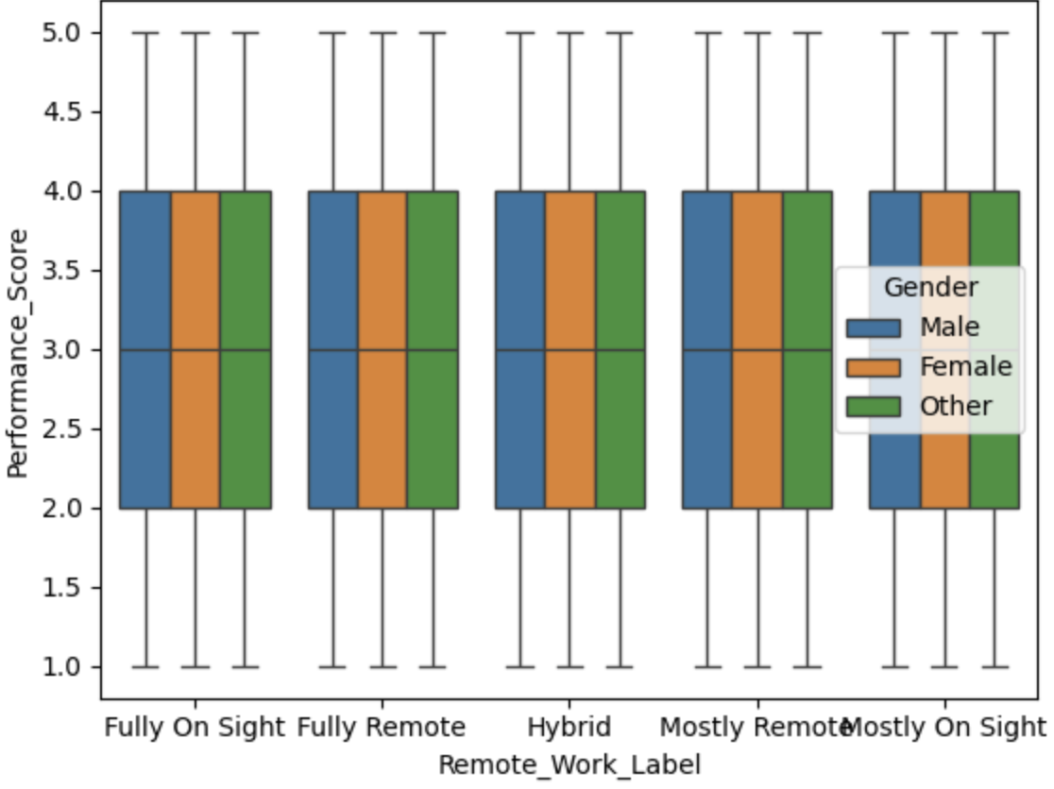
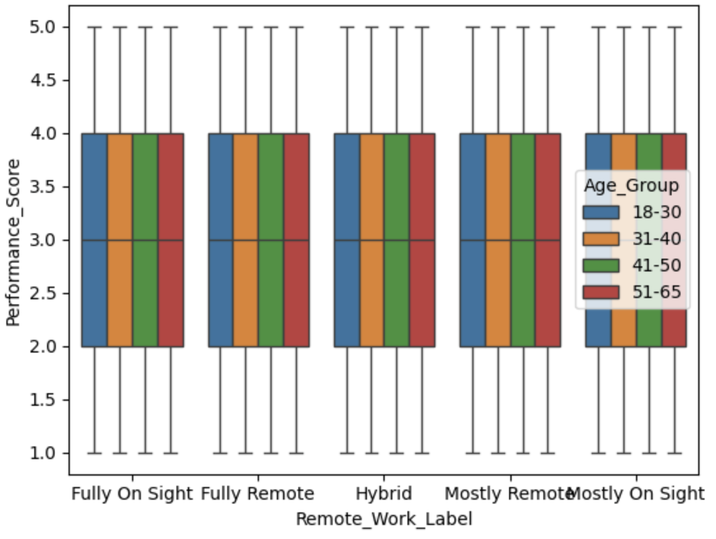
04
FINDINGS
Notes:
I ENDED Up trying so many different variation of visualization and it all stayed still across the board. From bar graphs to these boxplots . At first I was a bit disappointed thinking on no I not going to be able to use this data it doesnt tell me anything. And then I said wait Nothing is actually an answer. With this synthetic data there is no distinction of impact of remote work on performance score and not across gender or age either.

Slide 9
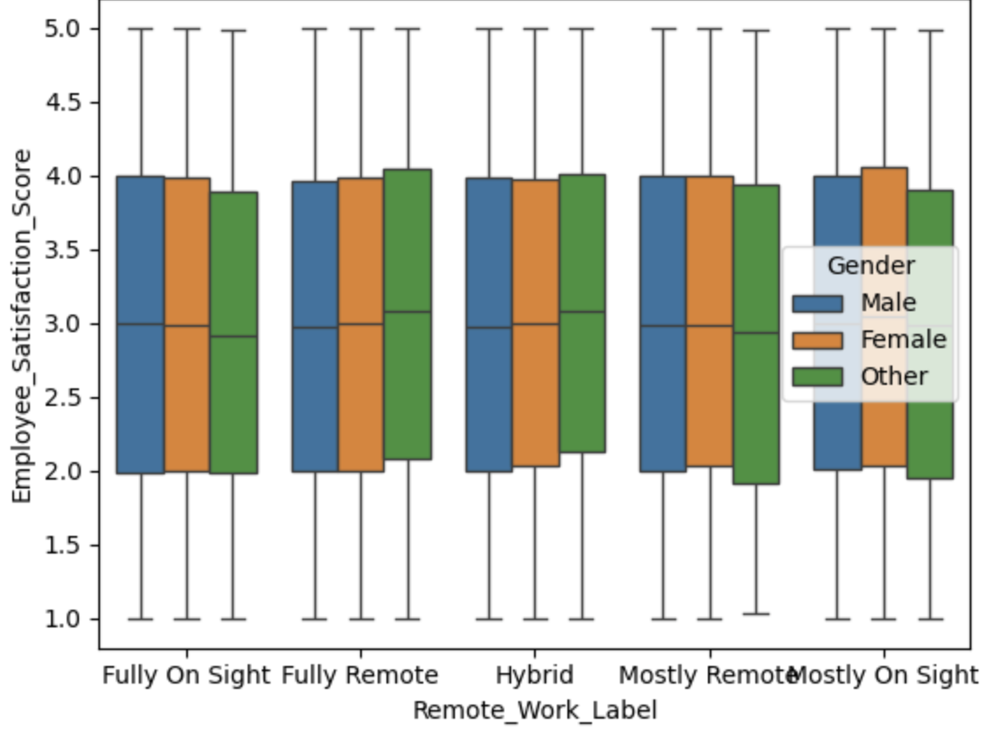
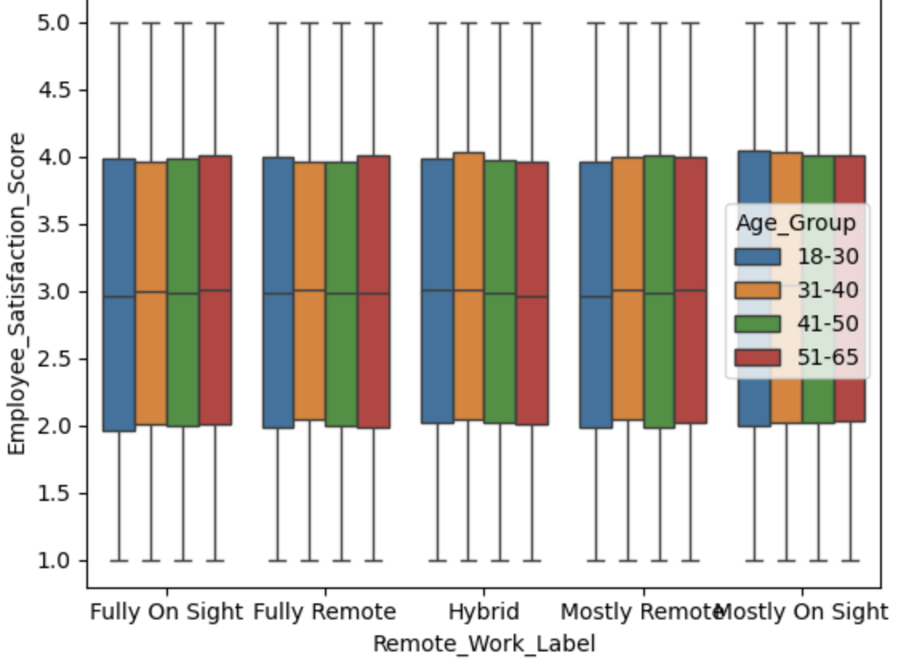
04
FINDINGS cont’
Notes:
When I move into employee satisfaction I see a slight more variations happening . However nothing that would really trend the data in one way versus the other. Overall people are doing there job well or poorly and hate or love their job accross the board regardless of remote impact.

Slide 10
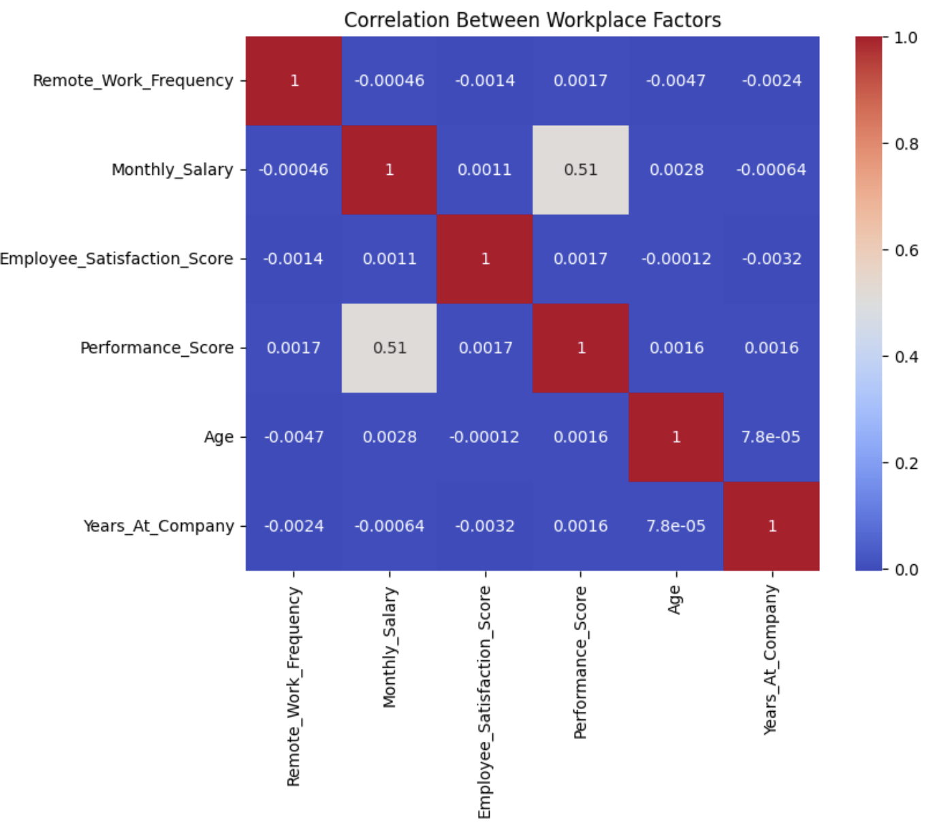
04
FINDINGS cont’
Notes:
I pulled in a heatmap to check for other factors like salary and years at the company and it further supported that results. The only thing that stood out is performance score and salary which I thought was cool reflection of work better get paid more which isnt always the structure we experience as a society.

Slide 11
Summary
Performance Score
Satisfaction Score
Averages out with no demonstration of impact from in person or remote work
Averages out with no demonstration of impact from in person or remote work
Age
Gender
Though only slight, Age demonstrated more of a relationship on satisfaction score than remote work in general. No impact on performance
Though only slight, Gender demonstrated more of a relationship on satisfaction score than remote work in general. No impact on performance
Age and gender did not demonstrate significant impact. The slight variation demonstrates ages 31-40 may have a slight higher job satisfaction in hybrid positions but unable to develop a firm conclusion that job location is the deciding factor. As for gender variations people that did not align male or female but fell into other demonstrated a slight impact on job satisfaction by remote and hybrid work vs on site option. Potential social implications and effects of the workplace.

Slide 12
05
Conclusion
The project examined whether remote work meaningfully affects employee satisfaction, employee performance, promotions, and workforce demographics. While some variation existed across remote work groups, the analysis did not reveal substantial differences or strong correlations.
This suggests that employee outcomes are likely influenced by a combination of factors beyond remote work availability, including but not limited to compensation, education, organizational structure, and job-specific conditions. Future analysis with additional workplace context or real-world organizational data may provide deeper insight into these relationships.
Notes:
In summary, my analysis looked at whether remote work meaningfully impacts employee satisfaction, performance, and other workforce characteristics. While some variation existed between remote work groups, the data did not show strong or significant relationships.
My overall finding is that remote work alone may not be a major driver of employee outcomes. Instead, factors like salary, education, organizational structure, and job type likely have a stronger influence. This project also highlights how workplace behavior is multifaceted, and that deeper analysis using additional organizational context could help explain these patterns further.

Slide 13
Acknowledging Gaps
06
It is important to recognize factors that may influence my findings:
Synthetic Data
Remote Policy Context
Industry / Role Differences
Individual Employee circumstances
Satisfaction/ Performance scores are Subjective
Correlation ≠ Causation
**Looking at a more aggregate level to measure the impact of remote work on economic performance across 43 private sector industries, Fernald et al. (2024) find little relationship between labor productivity and the ability of workers in an industry to work entirely remotely, suggesting remote work neither hindered nor helped raise aggregate productivity growth. (BLS)
Notes:
I did want to see if there was anything out there that maybe even had less data to review that could give me anything supplemental. I found that BLS did study on productivity growth and remote work impact and also found little to no relationship so the data may truly be in alignment with societal factors.
Id be intrigued to see the data of the HF results and take a scope into it and what decision were made as a result of the outcome.

Slide 14
—Albert Einstein
“The world as we have created it is a process of our thinking. It cannot be changed without changing our thinking.”
Notes:
Finally a little quote to leave you all with a lyttle quote

Slide 15
THANK YOU!
Questions?
Comments?
Slidesgo. (n.d.). Slidesgo. https://slidesgo.comFlaticon. (n.d.). Flaticon.
https://flaticon.comMagnific. (n.d.). Magnific. https://magnific.ai
https://www.kaggle.com/datasets/mexwell/employee-performance-and-productivity-data
https://www.bls.gov/opub/btn/volume-13/remote-work-productivity.htm
https://www.census.gov/programs-surveys/acs

